Slide 1
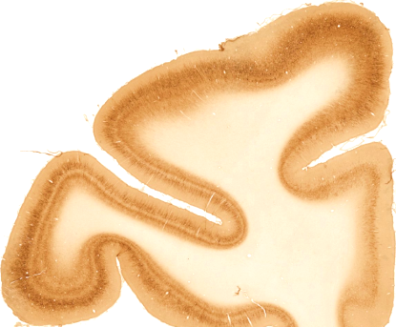
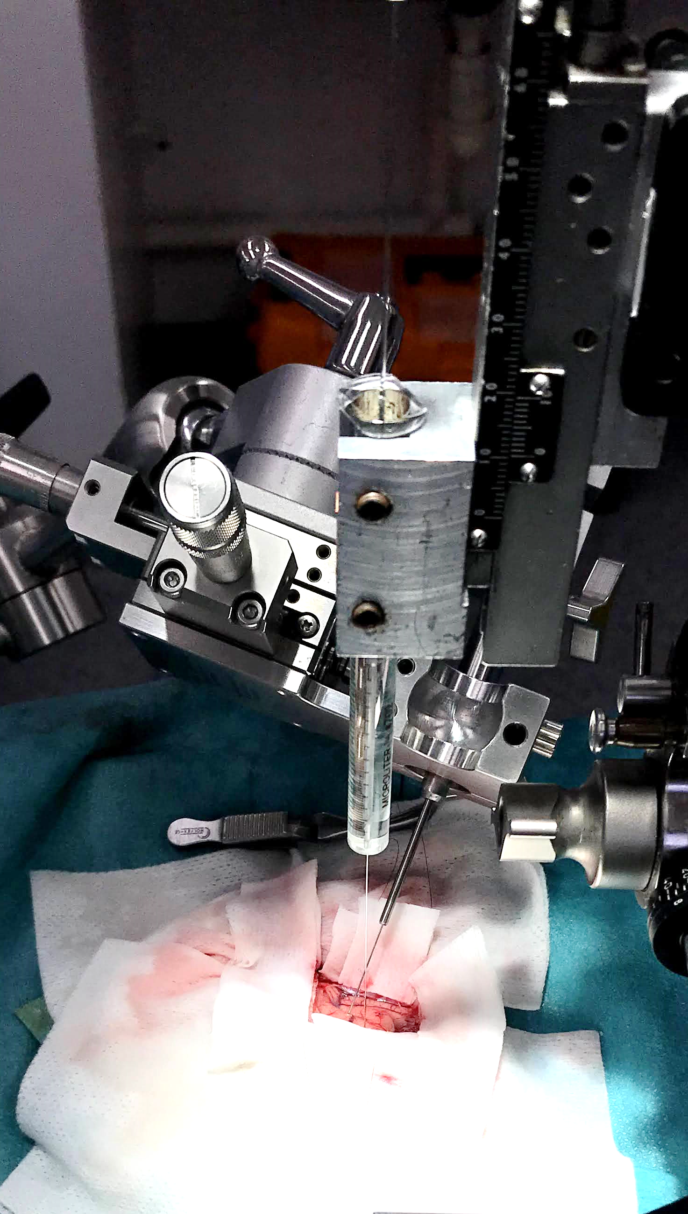
AAV hSyn-
DIO-hM3Dq-mCherry
CAV2-Cre
LPFC
MCC
CAV2-Cre
AAV hSyn-
DIO-hM3Dq-mCherry
Frontal section rhesus

Slide 2
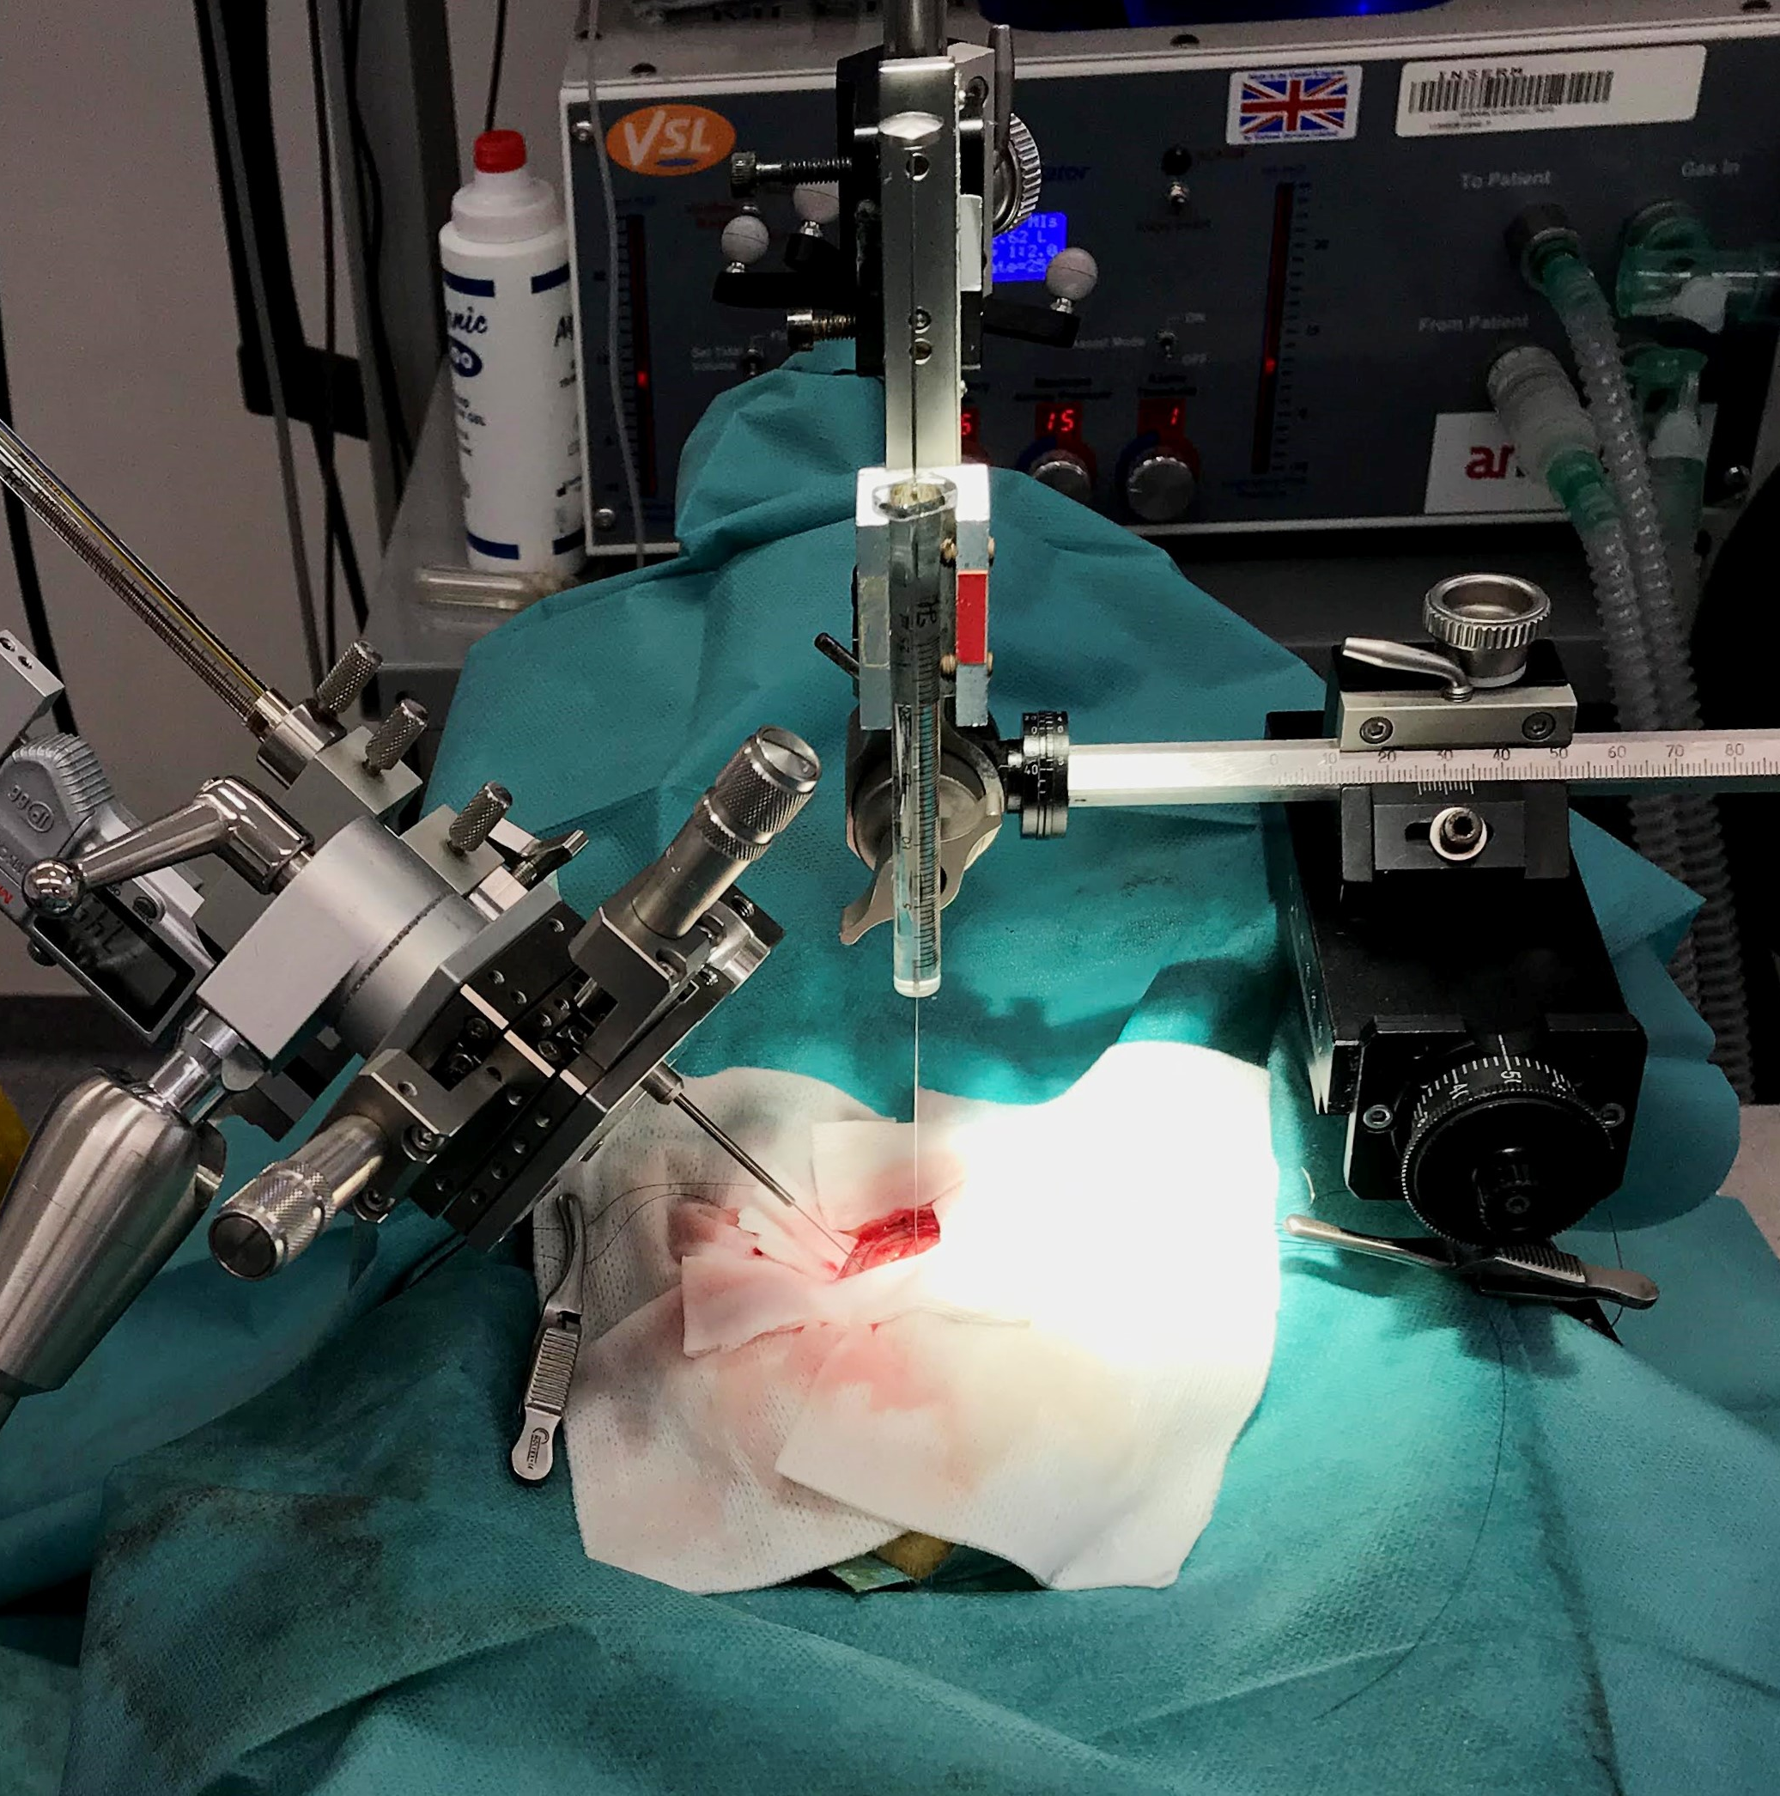
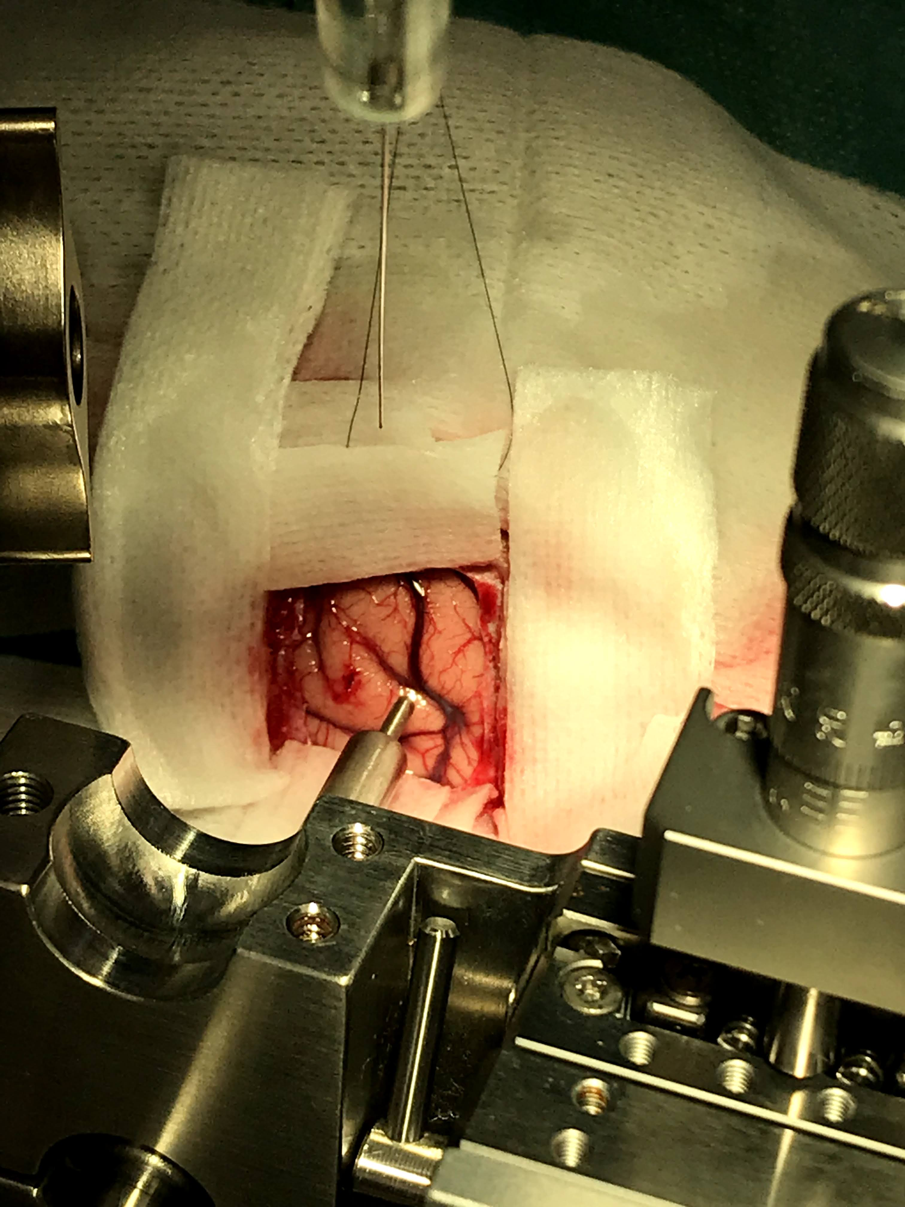
Surgeries : vectors injections for chemogenetic or optogenetic
MCC : AAV5-hSyn-DIO-hM3D(Gq)-mCherry
12 injections of 1μl
6 tracks, 2 depths per track
DLPFC: CAV2-Cre
19 injections of 1 μl
7 tracks, 3 or 2 depths per track depending on anatomy

Slide 4
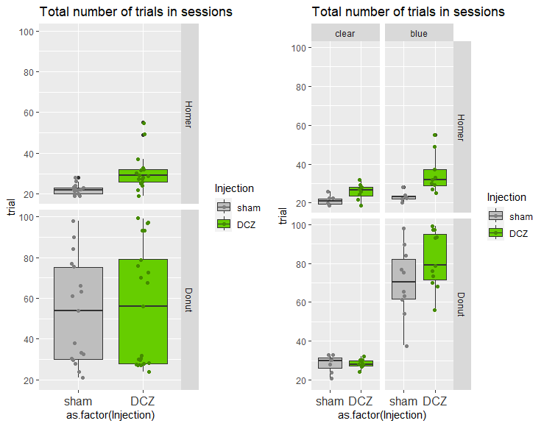
Donut // full model
InjectionDCZ -0.001006 0.092446 -0.011 0.991
portesblue 0.909635 0.080259 11.334 <2e-16 ***
InjectionDCZ:portesblue 0.149585 0.105226 1.422 0.155
Homer // full model
InjectionDCZ 0.19301 0.11244 1.716 0.0861 .
portesblue 0.08142 0.11826 0.688 0.4912
InjectionDCZ:portesblue 0.22698 0.14823 1.531 0.1257
P< 10-5
P< 10-5
ns
P< 0.002
Monkeys made more trials in the Opaque condition under DCZ

Slide 5
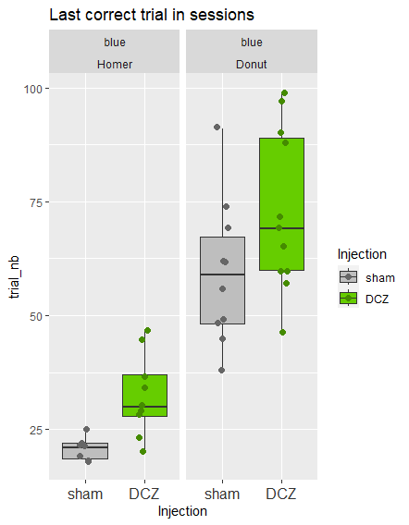
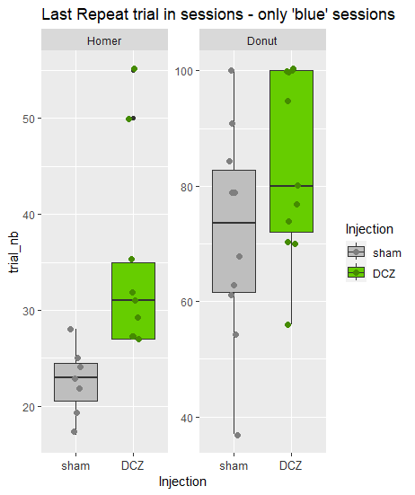
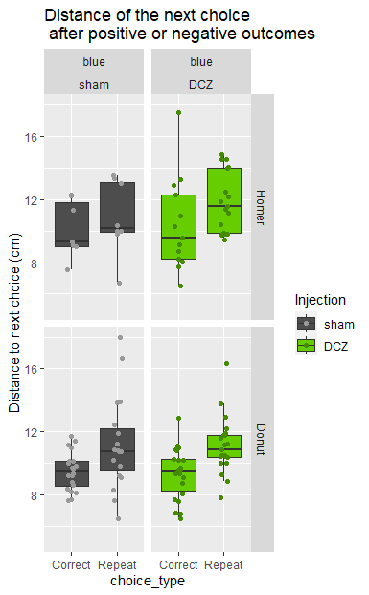
No effect on post-outcome distance
***
***
***
***
Animals took longer to take rewards under DCZ
They actually take more rewards even in clear conditions
(more persistent/compulsive?)
Animals repeat more often previously selected holes

Slide 6
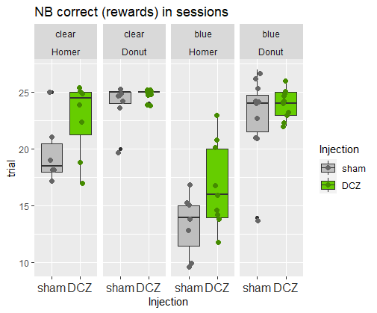

Slide 7
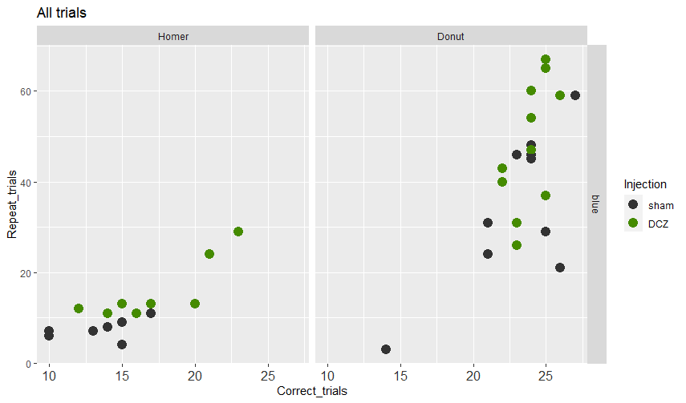
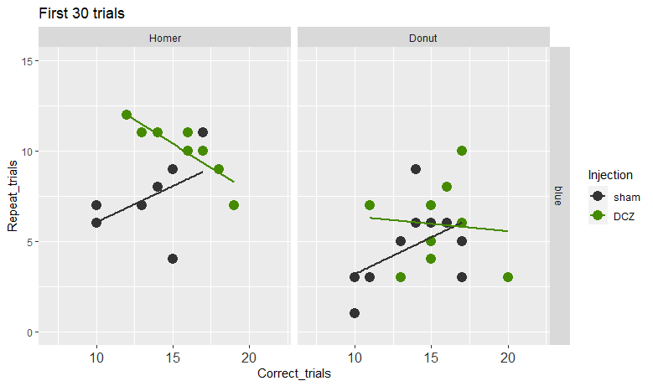
In theory, the longer the animal searches, the more reward it finds, but also -if its search is non-optimal- the more repeats it should do. THUS #repeats and #Correct should be positively correlated.
This is what we see for the ALL TRIAL figure on the left.
But the plot for the first 30 trials, shows a reverse relationship under DCZ:
Interaction: p<0.02
ns
Check data about MISSes
Figure with miss, and/or with All_trials

Slide 8
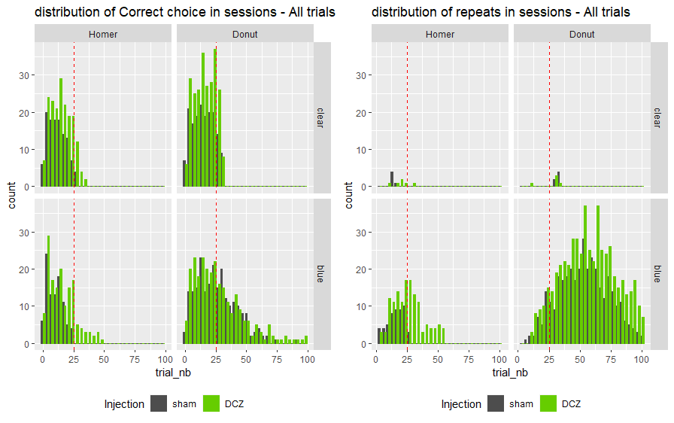
?

Slide 9
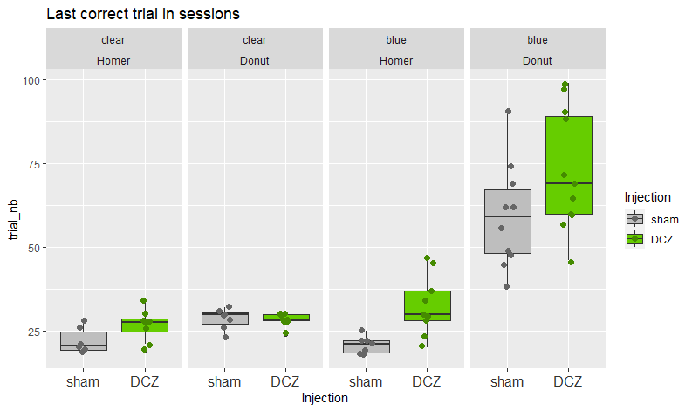
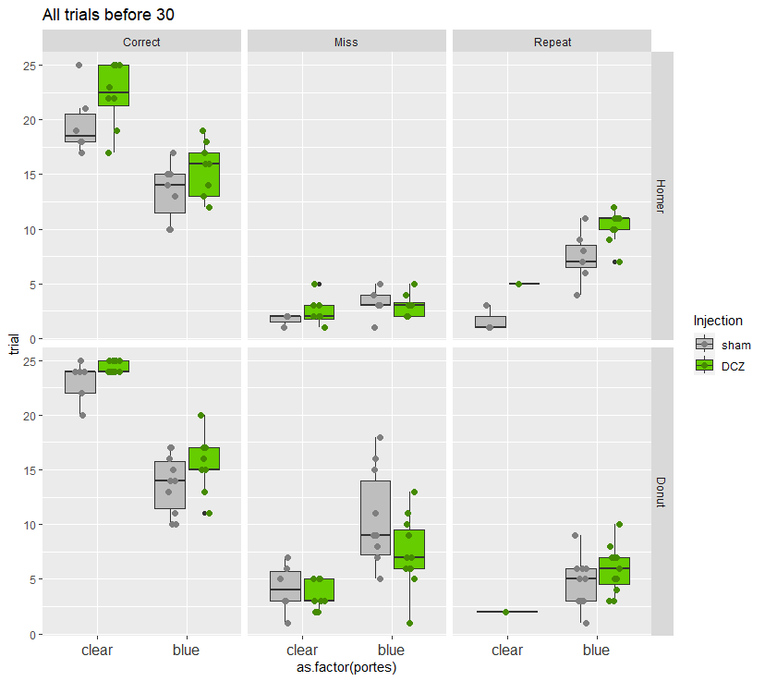
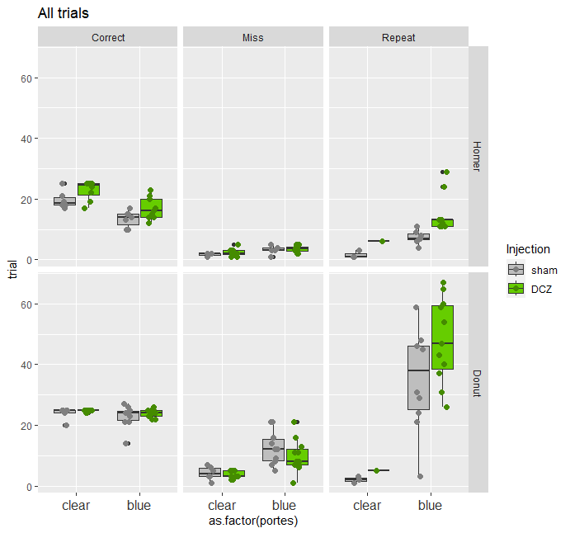

Slide 10
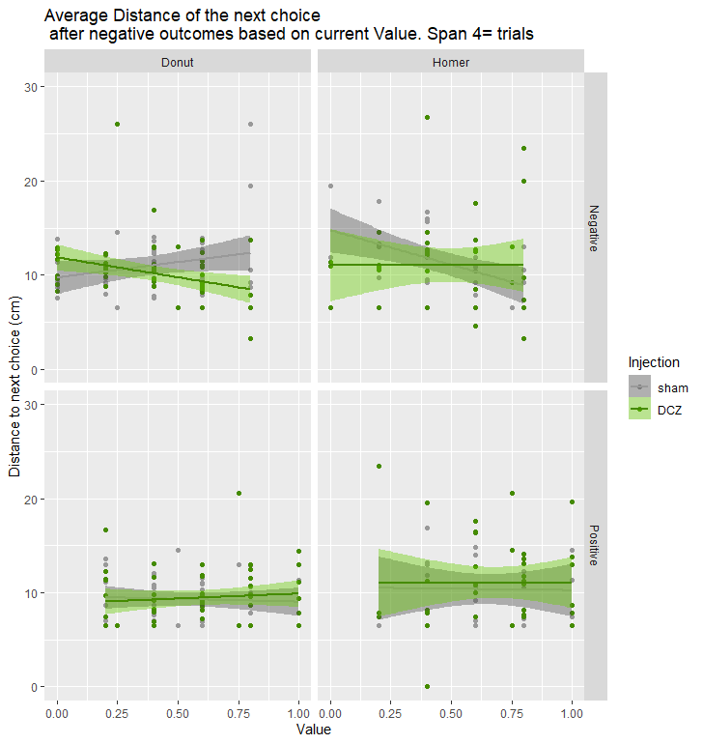
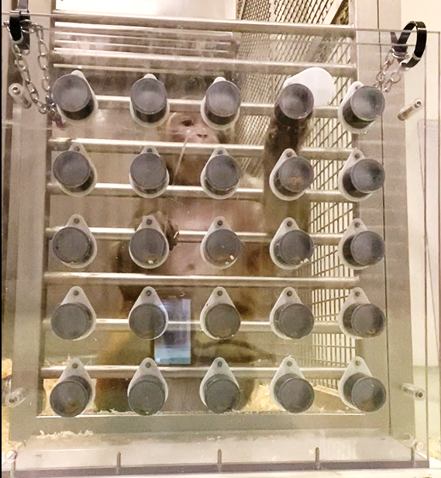
Value:InjectionDCZ -7.5246 2.3665 -3.180 0.00195 **
Value:InjectionDCZ 10.885 5.675 1.918 0.0600 .
Open no take
v
Rwd falls
Looks away
NS
NS
v

Slide 11
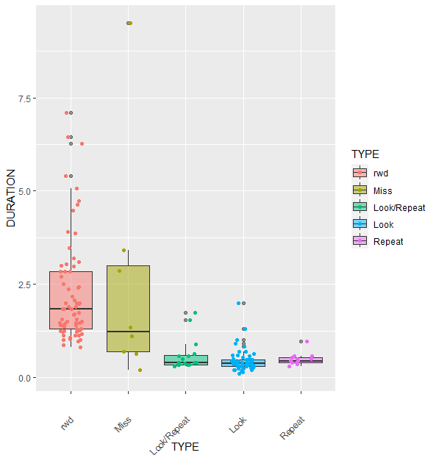
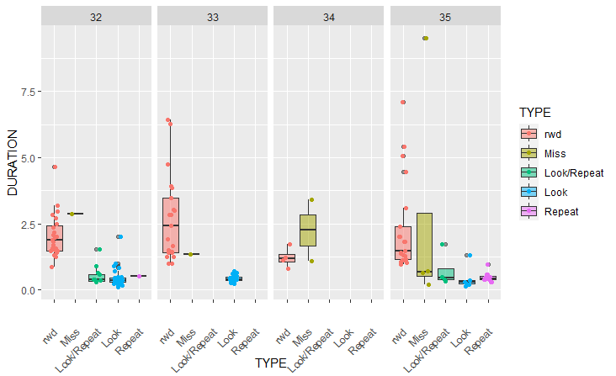
Homer

